Slide 1
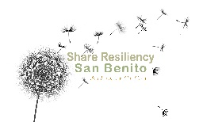


First 5 San Benito &
Family Impact Center
2021-2022 Evaluation and Data Report
Lisa Colvig-Niclai M.A., Vice President of Evaluation
Liat Sayfan Ph.D., Project Manager
Maria Usacheva Ph.D., Senior Research Analyst
October 26, 2022
Notes:
I'm so pleased to be with you here today! It's nice to be back and always fun for me to share the results from the annual evaluation, which demonstrates the great work that's being done in the community to support children youth and families. For the commissioners, THIS PPT IS AN ABBREVATED VERSION OF THE EVALUATION REPORT YOU WILL BE VOTING ON. CONTENT IS THE SAME
F 2020-21 PPT for reference: F5 SB Family Impact Center Data Presentation October 2021 FINAL.pptx

Slide 2

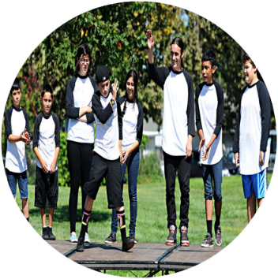

Theory of Change
Healthy Children | Engaged Youth and Parents | Supportive Community
Improved health status
Improved child and youth education and engagement outcomes
Increased family stability and protective factors
FIC
Resiliency Network
First 5
First 5
Family Impact Center
Resiliency Network
Notes:
Before we move on to the overview of results summary, I wanted to provide you with a framework that is helpful for understanding a bigger view of how the provided services and supports are expected to lead to positive outcomes in the community.
This visual represents the Theory of Change, which provides guidance on the specific ways through which we can improve health, child and youth development, and education outcomes, as well as family stability.
This is achieved by strengthening protective factors in families and communities, through investments in three areas of intervention: Healthy Children and Strong Start programs, overseen by F5, Engaged Youth and Parents programs, overseen by FIC, and Supportive Community initiatives, overseen by the Resiliency Network collaborative.
Within each component, the level of support provided to families increases proportionally to families’ needs.
At the lowest level of supports are Health Promotion activities, designed to provide universal supports to nearly all families in the community. Examples of such activities included efforts like distributing new parent kits (N = 314 in 2021/22) and systems change activities.
Next level up is taken by the Prevention services, which aim to provided services and supports to children and families who may need additional supports due to some personal and structural challenges. These services included enhancement of kindergarten readiness for young children and parent education programs for their caregivers.
Finally, Intervention services offer more intensive supports, targeting children and families with a higher level of need and vulnerability. These services include home visiting and case management for families referred by CPS.

Slide 3
Protective Factors
Family Functioning/Parental Resilience
The ability to manage stress and function when faced with challenges, adversity, and trauma
Social Connections
Positive relationships that provide emotional, informational, instrumental and spiritual support
Knowledge of Parenting and Child Development
Understanding child development and knowing strategies to support children’s development
Nurturing and Attachment/Social and Emotional Competence of Children
Positive parent-child interactions, including being emotionally responsive to children’s needs
Concrete Support
Access to basic needs, including food and shelter
Notes:
A key set of desired outcomes common to all the services and supports received by parents revolves around strengthening 5 protective factors.
For children, such key areas involve building their capacity for emotion regulation and social-emotional skills, which are key components of behavioral competence. A plethora of research finds that children who can listen and follow rules have better relationships with other family members, with peers, and teachers, and are more likely to succeed academically.
Emotion regulation in young children is closely linked to the home environment. To this end, strengthening parent-child relationships through attachment-based parenting and family activities is critical. In turn, parenting quality is often affected by family-level factors, - how well caregivers can cope with stress and support each other, and whether they have access to social support and ability to find resources needed to meet material, physical, and socio-emotional needs.
So, programs that aim to build up these internal strengths and facilitate access to external resources represent vital supports for positive growth and development in children and youth and increase family resilience, which helps families recover from adverse experiences, including social isolation and material hardship amplified by the global pandemic.
In line with this model, First 5 San Benito and the FIC sought to address community trauma and social inequities that were both caused by and exacerbated by the pandemic by focusing on services and programs that build on these protective factors.

Slide 4
PARTICIPANT CHARACTERISTICS
Notes:
To give you some context about who is served by these programs, we will first share the demographic profiles of this years’ families and children and summarize the needs reported by participants of these programs.

Slide 5
Characteristics of Participating Children
Source: Family Intake Form 2021-22. N = 134 for gender; N = 147 for age; N = 144 for special needs; N = 135 for ethnicity/race.
Notes:
**updated notes**
Based on the intake survey, more than half of the children (57%) were girls (in comparison, last year 58% were boys).
Over half of all children (52%) were under 3 years of age, with only 17% being 6 and older (whereas last year, over 55% were 6 and older).
Just about 2% of children had a diagnosed special need according to the parent (compared to 13% last year).
In terms of race and ethnicity, 8 out of 10 children were Hispanic/Latino, 13% were white, and 4% were multiracial.

Slide 6
Characteristics of Participating Caregivers
Source: Family Intake Form 2021-22. N = 96 for relationship; N = 91 for age; N = 80 for pregnancy; N = 84 for ethnicity/race.
Notes:
**updated notes**
Caregivers also reported information about themselves on the intake survey, - 4 out of 5 parents were mothers, - 1 in 10 was expecting. Nearly half (45%) were 30 to 39 years old. Race/ethnicity of the caregivers was similar to that of their children: 13% were white, and 2% - multiracial, - about half as many as children. The majority (85%) were Hispanic/Latino. Of these families, more than half (65% of Latinos or 55% overall) spoke English and 35% (of Latinos, or 30% overall) spoke Spanish. All in all, the demographic distribution of families served by F5 and FIC is skewed toward the communities of color, who are most likely to be affected by socioeconomic disparities. For instance, countywide, 67% of children are Hispanic/Latino, and 2% are multicultural, compared to the 83% of Hispanic/Latino and 4% multicultural children, served by these programs. In contrast, countywide population of white children is at 27.9%, whereas these programs served around 13%. This may be useful to keep in mind as we move forward, since we won’t be presenting results of participation in programs and services by race/ethnicity.
**from last year**
We hope to conduct and share further analyses and have some outcome data by demographics for the January presentation.

Slide 7
Families' Concerns
Source: Family Intake Form 2021-22. N = 130.
Notes:
*** updated notes ***
Families also reported what they were most concerned about. The greatest number of families experienced parenting stress due to difficult child behaviors. These concerns were closely followed by worrying about family’s ability to pay rent, difficulties with partner or spouse, and feeling hopeless or depressed. Additionally, some families struggled with lack of health care services and food insecurity. Families were least affected by substance use issues. This is in line with the general trend we saw last year, except this year 13% more parents are at least somewhat concerned with child behavior, 8% more experience issues with their partner. A slight drop (1-4%) in families reporting no concerns was also observed across other indicators. It is possible that some families are experiencing the aftereffects of the global pandemic, which placed additional strain on families’ abilities to meet basic needs, maintain health, and cope with stress, affecting family relationships and child behavior.
Top 3 in 2019: rent 46%, children's behavior 37%, and food/depressed = 36%
Top 3 in 2020: child behavior: 43%, rent 39%, issues with partner/spouse 33%.
Top 3 in 2021: child behavior: 56%, rent 38%, issues with spouse/depressed 25%

Slide 8
Top Referrals Needed
Source: Family Intake Form 2021-22. N = 130.
Notes:
**updated notes**
The services sought by families largely corresponded to families’ needs. The top 3 priorities were the same as last year: 7 out of 10 families wanted classes on parenting and child development – up from 56% last year; 6 out of 7 families sought programs on early literacy and kindergarten readiness (same as last year), and 4 out 10 looked for help managing child emotional or behavioral problems – almost twice as many as last year (24%).
About 10-20% of families were in need of food programs, child care, family counseling, social connections with other parents, child developmental screening, physical and mental health, and housing.
Between 1 and 10% of families sought recreational activities for their children, needed special needs supports for their children or disability services for themselves, help with family and immigration law, employment and transportation, and child welfare system navigation.

Slide 9
HEALTHY CHILDREN
& STRONG START
Notes:
**updated notes**
And now I'm going to talk about the efforts of First 5 San Benito and its partners to support the health and development of young children.

Slide 10
Quality Counts
Low
High
Source: Quality Counts Post Survey 2021-2022. N = 55. Survey is a retrospective pre-post.
***Statistically significant, p < 0.001.
Notes:
***updated notes ***
First, First 5 San Benito develops the capacity of early learning providers through Quality Counts, a program that offers trainings, coaching, and other supports to improve the quality of care provided. In FY 2021-22, XX providers were enrolled in the program.
At the end of the year, providers completed a survey on how the program had impacted their ability to support kindergarten readiness of children in their program. By the end of the program, participants reported significant improvements in all relevant competencies, compared to pre-program levels. The greatest self-reported increase in skills related to providers’ ability to support children’s social-emotional development. At program conclusion, all participants said that they would recommend the program to another provider.

Slide 11
California Preschool Instruction Network
“The trainings […] have really helped me support the development of the children in my care. These ongoing professional development trainings have kept me up to date on how children learn and develop. I have also been able to obtain new curriculum resources and more.“
-CPIN participant
Source: San Benito Apricot Data Management System 2021-2022.
Notes:
**Updated notes **
First 5 San Benito sought to build up the capacity of early learning providers by sponsoring California Preschool Instruction Network (CPIN) trainings. Over the past year, CPIN facilitated 17 trainings – 3 times more than last year - for a total of 553 providers. On average, each training was attended by 30+ providers. The trainings followed the California Preschool Learning Foundations curriculum, covering the topics of Play and Social-Emotional Development, Language and Literacy, and Early Learning, with the focus on strengthening community of Early Learning Professionals.
Participants completed assessment questionnaires, where they indicated perceived level of usable knowledge and skills on the presented topics before and after the training.
On average, participants rated their knowledge at a XX out of 4 before the training and XX out of 4 after the training.
***from last year ***
One participant remarked…”Given how much social emotional well-being has been impacted by the pandemic it's nice to see these professionals felt supported in building social emotional skills.”
*** last year trainings offered: 6, providers attended: approx. 120.
*** this year trainings offered: 17, providers attended: 553

Slide 12
Getting Ready for Kindergarten – Parent Survey
Source: Getting Ready for Kindergarten Post-Survey 2021-22. N = 21.
Notes:
*** updated notes ***
21 children entering kindergarten and their caregivers participated in Getting Ready for Kindergarten, a program that helps prepare families with young children for public school entry.
Through program participation, parents learn what to expect when their children enter kindergarten and how they can help increase their child’s academic readiness.
At the end of the the program caregivers fill out a survey, reflecting on learned parenting knowledge and skills that they can use to support their children to prepare them for kindergarten.
Based on this survey, all caregivers agreed that the program was useful for their families in various ways. All parents appreciated information on how to help their child make healthy food choices and how to talk to their child about feelings. 100% of parents felt more confident in their ability to help ready their child for school and 95% had a better understanding of specific strategies, like reading, to achieve that goal. 9 out of 10 caregivers said the program motivated them to get involved in their child’s schooling, and that it answered at least one question or concern they had about kindergarten.

Slide 13
Getting Ready for Kindergarten – Child Readiness Scores
1 = Not Yet
2 = Beginning
3 = In Progress
4 = Proficient
Source: Pre-Kindergarten Observation Form 2021
Note: Scale: 1 = Not yet, 2 = Beginning; 3 = In Progress; 4 = Proficient.
Sample sizes: Self-Regulation, Social Expression, Motor Skills, and Overall: N = 4 (19%); Academic Readiness: N = 21 (100%).
Notes:
**updated notes**
At the end of the year, early learning professionals who were part of the Getting Ready for Kindergarten program staff assessed kindergarten readiness of children enrolled in the program, using the Prekindergarten Observation Form (P-KOF). Providers assessed mastery of 20 related to social expression, self-regulation, academic readiness, and motor-skills. The chart shows average scores of children in the program in each of these domains, plus the overall score.
**updated - delete if not needed**
Compared to the 2020 cohort, this year children scored somewhat lower across all domains of early school readiness, particularly in the areas of self-regulation and social expression. It is likely that we are seeing the lingering effects of the pandemic, when many children had limited opportunity for socializing with others, and as a result, their social-emotional development may be slightly behind the rate of their peers assessed before the pandemic.
The overall score for this year is below a 3, indicating that more children were “Beginning” or “In Progress” on their development of readiness skills, compared to last year, when more children were “in Progress” or “Proficient.”

Slide 14
Home Visiting (Parents as Teachers) with children 0-5
“With the support of the program I was able to connect with my children. We did a lot of activities. I learned positive parenting and had someone to talk to throughout Covid.”
-Home visiting participant
Strengthening Families Survey (SFP FN 3-9; 2021-2022). Scale: 1 = never; 2 = rarely; 3 = some of the time; 4 = most of the time.
Positive parenting composite score is an average of 19 items, α = .79. N = 30. **Statistically significant at p < 0.01.
Notes:
***updated notes***
First 5 San Benito provided home visiting services to families with children 5 years old or younger, based on the Parent as Teachers curriculum. Weekly virtual visits aimed to help families develop positive parenting skills and support their child development and early school readiness. In the wake of the COVID-19 pandemic, home visitors also helped families manage stress and social isolation. Over the past FY, First 5 San Benito home visitors supported 40 families with 88 children aged 0-5. During these visits, early childhood specialists conducted a total of 85 ASQs-3 and 85 ASQs-SE developmental screens.
At the end of the year, caregivers in the program were asked questions about the frequency of use of positive parenting techniques and the perceived quality of relationships with their children.
The chart shows that from intake to exit, families used positive parenting strategies, such as listening to their children, showing love and respect, setting healthy boundaries, and spending time together, more frequently. Parents also reported feeling closer to their children, indicating that the program also improved the quality of a parent-child relationships, important for healthy growth and development.
One home visiting participant described their experience in this way…
**Notes from last year **
…Before going onto the next section, lets pause and give a round of applause for the great work of our partners supporting young children! If you'd like you can use the zoom reaction button at the bottom of your screen
Last year parents in the program were compared to national average norms reported by survey developers. More information available here: https://curry.virginia.edu/faculty-research/centers-labs-projects/castl/measures-developed-robert-c-pianta-phd

Slide 15
Success Story: The Gorecki Family
“Thank you so much for the information, I really appreciate everything you have helped us with. It takes a village, and I am proud to think of First 5 as part of our village.”
- Ms. Gorecki
When Ms. Gorecki came to First 5 and The Family Impact Center, she and her little one had no prior connection to this community. This made the Home Visiting Program perfect for this family. They were going through a hard time. Ms. Gorecki was trying to make sure all the basic needs for her daughter were taken care of while going through a family transition and coping with the hardship brought on, in part, by the pandemic. With the support of the First 5 and the FIC team, Ms. Gorecki and her daughter were able to get to a more stable and happier place. Some of the services that supported them during this time included: home delivery of food and emergency supplies, parent education groups, home visiting’s developmentally appropriate activities, and developmental screenings.
Ms. Gorecki is now enrolled in college. She is majoring in social work to give back to the community someday. With the help of the home visiting program, she was able to enroll her child in preschool and get her child further developmental assessments. The Gorecki family now feels fully supported by, and connected to, the community.

Slide 16
ENGAGED YOUTH AND PARENTS
Notes:
**updated notes**
Interventions to support youth and their families at the FIC included case management and parenting programs for caregivers and youth. Program referrals based on families’ needs were made possible through a collaborative effort between the FIC, the San Benito County Sheriff’s Office, and the San Benito County Health and Human Services Agency.

Slide 17
FIC Case Management
Case management provided weekly to 23 caregivers and 8 children
Families were connected to concrete supports and services in the community
Many also received instruction on how they could best address their children’s needs and improve parent-child relationships
Notes:
***updated notes***
To provide caregivers and their families with essential supports, FIC staff continued to offer virtual case management services. During the weekly meetings, 23 caregivers and 8 children were offered material and therapeutic supports and linked to other services in the community, based on individual and family needs. Many of these families received guidance on how they could best address their children’s needs and improve parent-child relationships. This is a significant drop from last year's 63 families and 134 children who sought relief for the destabilizing effects of the COVID-19 crisis through these services.
This quote helps illustrate how important the support they received was to this family...

Slide 18
Parent Education & Family Strengthening (Triple P)
“As a parent, I feel more confident knowing what is best for my child and my family. I’ve learned to be more present with my child, and to remember to take care of myself, - to remind myself that I’m doing a good job.”
-Triple P participant
Source: Strengthening Families Survey (SFP FN 3-9 and SFP FN 10-14; 2021-2022). N = 30.
Scale: 1 = never; 2 = rarely; 3 = some of the time; 4 = most of the time. Positive parenting composite score is an average of 19-20 items, α = .80. **Statistically significant at p < .01.
Notes:
***Updated notes***
Another type of services offered in local communities was the Family Strengthening Program, based on the Triple P evidence-based curriculum. During weekly virtual home visits, families learned about child development and positive parenting strategies known to improve parent-child relationships and support achievement of developmental goals of children aged 3-9 and youth aged 10-14, served by age-adapted versions of the program. Following program completion, Triple P caregivers reflected on their current use of positive parenting practices, compared to the frequency of use of such practices before they started the program. As the chart shows, the use of positive parenting practices increased over time. At program exit, parents more often spent quality time with children, talked about family rules, made an effort to show love and affection, and listened to their child without criticizing.
*** notes from last year ***
(I) Wait to deal with problems with my child until I have cooled down. PRE
Help my child understand what the family and house rules are. PRE
Take time to do something fun together as a family. PRE
Find ways to keep my child involved in family work activities. PRE
Spend special time one-on-one with my child. PRE
Talk with my child without criticizing. PRE

Slide 19
IMPACT ACROSS FIRST 5 AND FAMILY IMPACT CENTER PROGRAMS
Notes:
***updated notes***
Now I’ll be sharing some overall results on the common outcomes related to the protective factors that we expected to see for participants of the Family Impact Center and the First 5 San Benito programs.

Slide 20
Protective Factors
Source: Family Intake and Exit Forms 2021-2022. N = 76-78. Scale for “family activities”: 1 = not at all; 2 = 1-2 times, 3 = 3-6 times, 4 = every day. Scale for all other questions: 1 = not at all true; 2 = not very true; 3 = somewhat true; 4 = definitely true. *p < .05; **p < .01; ***p < .001.
Notes:
**Updated notes ***
At program intake and exit caregivers were asked to share some information about themselves, their families, and their children.
These questions aimed to collect information about known protective factors across 6 categories. For families, these included ability to meet their basic needs, having positive social networks and a supportive, united family that helps each other through life difficulties. For children, positive parenting and parent-child closeness help buffer from stress and support growth and development. Child self-regulation is another key protective factor, as children with better emotion-regulation skills have better behavior, which reduces parenting stress and improves parent-child relationship.
Caregivers used a four-point scale (1=Not at All True for Me to 4=Definitely True for Me) to report on these protective factors. After receiving services, parents reported significant improvement across all 6 of these protective categories. Parents felt better equipped to find resources and services to meet their needs (e.g., housing, food, employment). They also felt more supported outside and within their families. In turn, with increase in personal resources caregivers also reported an increase in their capacity to be more effective and supportive parents, and to invest in building their relationship with children through meaningful and stimulating family activities. As expected, these positive changes corresponded with perceived improvement in child behavior and self-regulation, helping family stabilization and creating supportive environments for children to thrive.
*** notes from last year ***
I know what program to contact in my community when I need help for basic needs
I have others who will listen when I need to talk about my problems
I can find someone to talk to when I need advice about how to raise my child
I know what to expect at each age as my child grows and develops
I know how to meet my child’s social and emotional needs
I feel supported as a parent
I am able to deal with the stresses of parenting and life in general
In my family, we take time to listen to each other
My family pulls together when things are stressful

Slide 21
Child Resiliency
Source: Family Intake and Exit Forms 2021-2022. N = 83-85. Scale: 1 = not at all true; 2 = not very true; 3 = somewhat true; 4 = definitely true. Significant at **p < .01; ***p < .001.
Notes:
**updated notes**
Caregivers also reported on changes in their child’s level of emotional and behavioral regulation, which underlies resiliency. This indicator was measured by child’s ability to adjust well to changes, calm themselves when upset, and stay calm and in control when faced with a challenge.
Caregivers indicated how true each statement was for their child. As seen from the graph, at program exit children were better able to stay calm and in control when faced with a challenges, compared to program entry.

Slide 22
Families’ Satisfaction with Programs and Services
80% of parent “strongly agreed” that they would recommend these services to others
70% of parents “strongly agreed” that the program helped them with the challenges they faced
90% of parents rated program topics, activities and materials, and facilitators as “excellent”
“As a father, the program has helped me be a man involved in my children's life and development. I feel that the activities have helped me and my daughter grow closer.”
“Activities helped my child with his tactile sensory processing. When program started my child did not like painting and he learned to love it with the support and help from the teacher. My child is now able to stay working on activities for longer periods of time. Great program and teachers.”
“Everything was helpful with both programs. I've been a part of your programs for some years now and it keeps getting better. Very appreciative of the support with the programs.”
Notes:
“As a father, the program has helped me be a man involved in my children's life and development. I feel that the activities have helped me and my daughter grow closer.”
At program exit, 7 out of 10 parents “strongly agreed” and 3 out of 10 “agreed” that the program helped them with the challenges they faced. Additionally, 80% of families “strongly agreed” and 20% “agreed” that they would recommend these services to others. Based on open-ended responses, about 20% of feedback highlighted satisfaction with all program components, including facilitators, content, activities, resources, and opportunities to connect with other parents. Positive experiences with program participation were linked to activities and materials for about a third of all families. Another third of all positive comments related to the choice of topics, including child development and parenting, early learning and kindergarten readiness, rules and boundaries, and parent-child connection. About 20% of caregivers had particularly appreciated supports and resources they had received from program specialists and other parents and learning about self-care.
“Everything was helpful with both programs. I've been a part of your programs for some years now and it keeps getting better. Very appreciative of the support with the programs.”
“Activities helped my child with his tactile sensory processing. When program started my child did not like painting and he learned to love it with the support and help from the teacher. My child is now able to stay working on activities for longer periods of time. Great program and teachers.”
Importantly, none of the participants were dissatisfied with programs and services. To the contrary, 9 out of 10 families rated program topics, activities and materials, and facilitators as “excellent” and 1 out of 10 rated them as “good.” Slightly fewer (8 out of 10) families agreed that the space was “excellent,” whereas 2 out of 10 said it was “good.” Overall, 95% of families rated programs and services they have received as “excellent” and 5% rated them as “good.”

Slide 23
SUPPORTIVE COMMUNITIES
Notes:
**updated notes**
Now, let’s take a look at the outcomes of the First 5 San Benito, the FIC, and their partners’ efforts to build a supportive community in the county through systems change activites that address complex issues impacting children, youth, and families.

Slide 24
Emergency Supply Distribution
First 5 CA partnered with child care providers to distribute:
FIC food and supplies:
2,800 bags
SBC FOOD BANK | 2021 | 2020
PPE | 1499 | 3282
Baby Food | 1506 | 272
Wipes | 1861 | 263
Diapers | 4683 | 1506
Source: Emergency Supply Distribution Tracker. Approximately 30 FIC families also received food and other supplies each month,
from July 2021 to July 2022
Notes:
*** updated notes ***
Following the pandemic, an estimated 17% of children in the county were food insecure in 2020, a significant increase from the 2019 rate of 11%. The prevalence of hunger and food insecurity is tightly connected with the pandemic-related reduction in working hours. For instance, in 2020, the unemployment rate was over 10% - double that of 2019. By 2021-22 there was a positive trend, with unemployment dropping to 7%, - however, employment still did not reach the pre-pandemic levels. So, even in 2021 many of the San Benito County families still had trouble paying for basic needs.
Compared to the February and March of 2021, when 280-300 families received emergency distribution supplies, these numbers were steadily decreasing, reaching the lowest point by July of 2021 and staying at around 100-120 families until winter holidays, when the distribution increased to serve 160-180 families and remained at that level until June of 2022. It may be worth noting that this graph shows the food bank distribution rates and does not reflect the demand for these supplies.
CLICK!
In addition, First 5 San Benito distributed various types of emergency supplies to 37 (??) early learning providers enrolled in Quality Counts throughout the year. In total, emergency supplies distributed via providers had significantly increased, compared to last year:
In 2021: 1499 units of PPE supplies (cleaning and personal hygiene items), - half of the 3,282 units distributed in 2020 (- including masks & gloves)
In 2021: 1861 packs of wipes, - almost 7 times over the 2020 amount of 272 packs of wipes
In 2021: 4683 packs of diapers – close to 20 times more than 2020 count of 263 packs diapers
Additionally, in 2021 families received 1506 units of baby formula and baby food.
Additionally, FIC distributed approximately 2,800 bags of food and supplies to an average of 25 families, who received about 2 bags per week each month between July 2021and June 2022. Families also received an extra box of food over the holidays.
*** from last year – needs updating because it’s confusing ***
Starting in February 2021, through a partnership with the food pantry, additional families received a box of food each week. The chart details the number of families receiving food and other emergency supplies each month from February to June 2021 ranging from 150-300 families each month.

Slide 25
Emergency Supply Distribution Partners
San Benito Health & Human Services San Benito County Department of Public Health San Benito County Child Abuse Prevention Council San Benito County Migrant Center San Benito Public Services San Benito County Sheriff’s Office San Benito County Chamber of Commerce/Foundation Community Businesses & Organizations Ridgemark Women’s Golf Club Crown Sanitation The Elders and Sisters of the Church/ the Church of Jesus Christ Latter Day Saints Dr. Marni Friedman, MD | California Non-Profits First 5 California/Association California Child Abuse Prevention Supply Bank San Benito Non-Profits The Community Food Bank of San Benito Go Kids San Benito United Way of San Benito San Benito Foundations & Trusts Sunlight Giving Foundation The David & Lucille Packard Foundation The Health Trust The Monterey Peninsula Foundation
Notes:
***updated notes***
The supply distribution was made possible by the contributions of the more than 20 different partners LISTED HERE.
**from last year**
Can we get a round of applause for the hard work that went into meeting the community's needs during the pandemic?

Slide 26
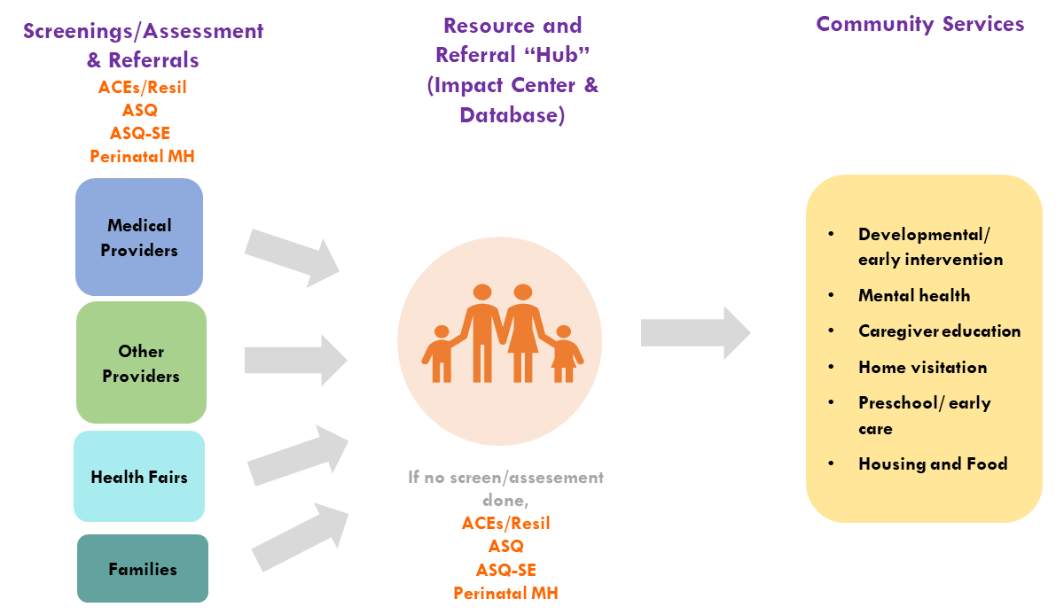
San Benito Resiliency Network of Care
Notes:
**last year notes**
This graphic summarizes the referral pathway that may begin with screenings and assessments conducted by medical providers and other providers, and those conducted at the resiliency network health fairs, which are then followed by referrals to the Resource & Referral Hub at the Impact Center. As the diagram illustrates, Families can also self-refer to the Hub. Apricot is an essential component of this hub, logging the referrals into the system and the screening results of families and then sending referrals out to community services based on those screening results. Staff also are CONTINUOUSLY BUILDING OUT a comprehensive n INVETORY OF SERVICES through the apricot system to support these outgoing referrals .
I'll discuss first sending referrals into the apricot system, corresponding to the left side of the graphic and then discuss receiving referrals from the apricot system, the right side of the graphic

Slide 27
San Benito County Resiliency Network Partners
San Benito Health & Human Services San Benito County Department of Public Health San Benito County Child Abuse Prevention Council San Benito County Migrant Center San Benito Public Services San Benito County Sheriff’s Office San Benito County Probation San Benito County Chamber of Commerce/Foundation San Benito County 211 Services San Benito County Free Library San Benito County Office of Education Community & Out-of-County Organizations The Church of Jesus Christ Latter Day Saints Santa Clara County Office of Education | San Benito Non-Profits First 5 San Benito Family Impact Center Healthy Mothers, Healthy Babies Coalition The Community Food Bank of San Benito Go Kids San Benito United Way of San Benito Emmaus House Youth Recovery Connections Ascending Families, LLC Transcend Educational Services Jacob’s Heart Children’s Cancer Support Services
Notes:
**updated notes**
To improve systems of care in San Benito County, First 5 San Benito and the FIC have organized a multisector collaborative to improve coordination, collaboration, and alignment among local agencies serving children and families. The San Benito County Resiliency Network (RN) is an umbrella collaborative that encompasses the Family Impact Center Advisory Council, Share Resiliency San Benito, and the San Benito County Home Visiting System Coordination Initiative. The RN Network is composed of over 20 local leaders, who met monthly (February-June 2021?) to influence systems change in the county.

Slide 28
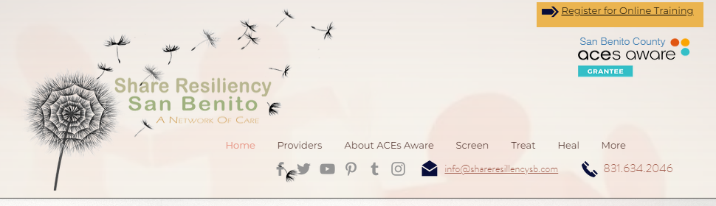
RN Training and Professional Development
PROVIDER TRAINING PARTICIPATION
The RN developed the Share Resiliency San Benito: A Network of Care website: https://shareresiliencysb.com
  Includes information for providers and families
  78 total visits to the website, of which 65 represented unique/first-time visitors
  2 informational bill boards (in English and in Spanish)
  ACEs Aware training completed by 19 RN members and 2 MediCal providers
Notes:
**updated notes**
One goal of the RN Network was to increase public awareness of ACEs and resiliency in the community. To address this goal, the RN network developed the Share Resiliency San Benito: A Network of Care website, which serves as a single point of access for providers and families on county resources and guidance related to ACEs screening, clinical interventions, and supports, to help local communities health from exposure to adverse experiences through trauma-informed care. This year, the website had 78 total visits, of which 65 were unique/first time visitors.
To further contribute to public knowledge of ACEs, the RN N&R Publications also partnered with the network to develop stories that raise awareness about the impact of RN partners’ activities on the community. The RN members also met to develop public messaging around child trauma and resiliency, which was communicated via 2 billboards, one in Spanish and 1 in English.
Another goal of the RN Network was to improve providers’ capacity to offer culturally sensitive, trauma-informed care. It contributed to this goal by encouraging medical service providers to complete the California ACEs Aware training. This year, the RN Network reached out to 5 MediCal providers, of which 2 completed the ACEs training. Additionally, 19 RN Network members completed this training. The ACEs Aware Outreach director also shared relevant professional development resources with the RN Network.
***supportive notes***
This year the website had:
78 total visits to the website (23% of total visits last year)
Of these, 65 (83%) represented unique visitors (41% of last year).
Last year: total visits = 333; unique visits = 138 (41%).
So, compared to last year, this year we had 3 times fewer follow up visitors (17%), compared to last year (59%).
But new visits almost doubled, compared to repeat visits: 83% vs 41%, but dropped overall, to 47% of last year.

Slide 29
F5 Funding and Sustainability
Total
$1,475,946
Notes:
***updated notes ***
As tobacco tax revenues continue to decline, following the statewide trend, First 5 San Benito sought to diversify its revenue sources to continue meeting the needs of local children and families.
First 5 San Benito’s total revenue in 2020-21 was $1.5 million,
- not counting encumbered (i.e., D&L Packard and Sunlight Giving Foundations; $145,833) or restricted use funds (e.g., Health Trust, $207,029, to be used for kitchen remodeling).
.
The revenue streams included:
Program-specific and collaborative grants, which I’ll present separately ($683,700);
Tobacco and e-cigarette taxes ($555,622);
F5 Small Population County Funding Augmentation (SPCFA; $200,109);
Other sources, like rental income, state surplus monetary investment fund, and private donations ($36,515).

Slide 30
Grants and Collaborative Funding
Total
$683,700
Collaborative
$509,533
Notes:
*** Updated notes***
Circling back to program-specific and collaborative grants, - in a climate of limited resources, partnerships like those forged through the RN network are critical to leverage and maximize funding.
Indeed, out of $688,700 in grant revenue, $509,533, or 75%, were awarded through collaboration between F5, the impact center, and partners in the community, including:
The San Benito County Sheriff’s Office, via the Federal Justice Assistance Grant [JAG]) → for prevention and education, including the Family Strengthening Program;
The San Benito County Health & Human Services Agency (H&HSA) → for child abuse prevention efforts, awarded by the state Office of Child Abuse Prevention (OCAP);
The Regional Hub for quality early learning supports, Quality Counts, and Home Visiting System Coordination Project, → for programs to support healthy development and early learning of young children in home and early learning care settings. These moneys also covered professional development and training of early care and education providers.
California Family Resource Association (CRFA) → to help connect family resource centers with allied organizations, networks, community leaders, and policymakers.

Slide 31
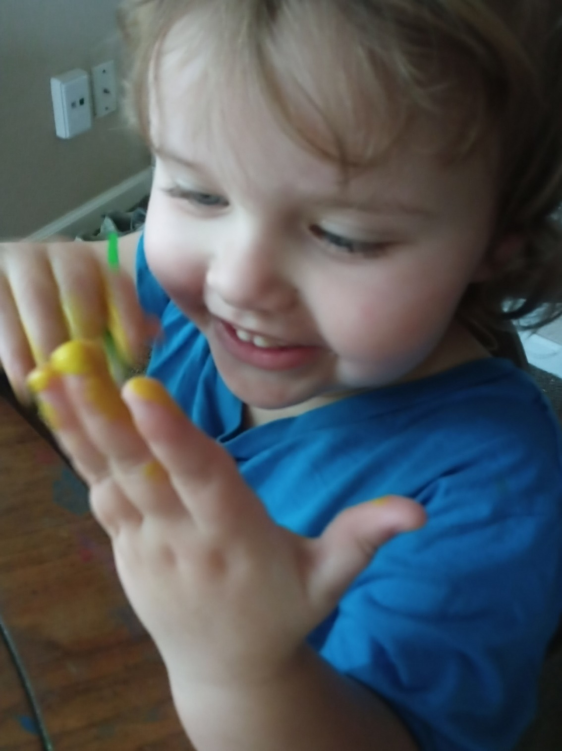


Questions?
Notes:
**updated notes**
That brings me to the end of the summary of outcomes for the First 5 San Benito and FIC evaluation report for 2021-22. As you saw, they provided services and supports and engaged in systems change activities that strengthened the protective factors of families, promoted resiliency, and strengthened the capacity of systems to deliver coordinated, aligned, and trauma-informed services to meet families’ needs. As the community continues to recover from the COVID-19 pandemic, the efforts of First 5 San Benito, the FIC, and the community partners will continue to be needed to promote social equity and the health and well-being of children, youth, and families in San Benito County.
Before talking your questions, lets give a big round of applause for the great work of our supportive community partners!

